Slide 1
COMP 224/INTE 216/BBIT 216
COMPUTER ORGANIZATION AND ARCHITECTURE
LECTURE THREE
ARCHITECTURE OF A MICROCOMPUTER SYSTEM
OMBUYA D.O.

Slide 2
Devotional Meditation
Zechariah 3:2-3
And he shewed me Joshua the high priest standing before the angel of the Lord, and Satan standing at his right hand to resist him.And the Lord said unto Satan, The Lord rebuke thee, O Satan; even the Lord that hath chosen Jerusalem rebuke thee: is not this a brand plucked out of the fire?

Slide 3
Lecture Outline
Review of the previous lecture
Item 1 … ENIAC Background
Item 2 … ENIAC specifications
Item 3 … Significance and Contribution
Item 4 … IAS (VON NEUMANN/TURING) macine
Item 5 ... Structure of the Von Neumann
Item 6 ... The IAS machine: Control Unit
Item 7 ... Commercial Computers
Item 8 ... Conclusion

Slide 4
ENIAC - background
Electronic Numerical Integrator And Computer
John Presper Eckert and John Mauchly
University of Pennsylvania
Trajectory tables for weapons
Started 1943
Finished 1946
Too late for war effort
Used until 1955

Slide 5
ENIAC: built 1937-1945, decommissioned 1955
42 panels, each 9’x2’x1’, ~200 tons
Housed in rare forced-air-cooled building
19,000+ vacuum tubes, 1500 relays
3,000 input switches
Manual cabling - setup could take days
Addition cycle 0.2ms (5 KHz), 1000x faster than Differential Analyzer

Slide 6
ENIAC’s contributions & significance
Noteworthy...
True parallel addition (think: the VLIW From Hell)
Historical origin of “accumulator”—reflects calculator legacy
Easy to see leap to data-bus-based architecture with true microcode
ENIAC: connect specific inputs to outputs with hardwired cables; different for each problem to be solved
true data bus: output from any unit available to all; operation being performed selects which one reads
MIT Whirlwind computer and Mark I calculator
punch cards would be used to do this selection: holes in cards route outputs to inputs and select operations hole patterns on card can be interpreted as data

Slide 7
IAS (von Neumann/Turing) machine
Stored Program concept
Main memory storing programs and data
ALU operating on binary data
Control unit interpreting instructions from memory and executing
Input and output equipment operated by control unit
Princeton Institute for Advanced Studies
IAS
Completed 1952

Slide 8
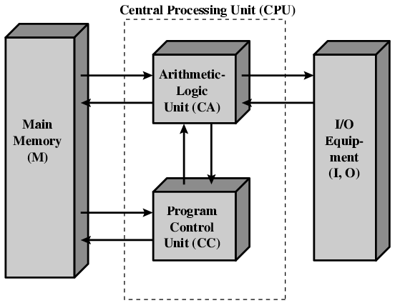
Structure of von Neumann machine

Slide 9
The IAS Machine: Control Unit
The control unit operates the machine by fetching instructions
from memory and executing them ONE at a time.
Central Processing Unit
Arithmetic and Logic Unit
Accumulator
MQ
Arithmetic & Logic Circuits
Main
Memory
Input
Output
Equipment
MBR
Instructions
& Data
IBR
PC
MAR
IR
Control
Circuits
Program Control Unit
Address

Slide 10
an accumulator is a register in which intermediate arithmetic and logic
results are stored.
MQ (Multiplier quotient) register Temporary-storage register whose contents can be transferred to or from, or swapped with, the accumulator.

Slide 11
Commercial Computers
1947 - Eckert-Mauchly Computer Corporation
UNIVAC I (Universal Automatic Computer)
US Bureau of Census 1950 calculations
Became part of Sperry-Rand Corporation
Late 1950s - UNIVAC II
Faster
More memory

Slide 12
IBM
Punched-card processing equipment
1953 - the 701
IBM’s first stored program computer
Scientific calculations
1955 - the 702
Business applications
Lead to 700/7000 series

Slide 13
Transistors
Replaced vacuum tubes
Smaller
Cheaper
Less heat dissipation
Solid State device
Made from Silicon (Sand)
Invented 1947 at Bell Labs
William Shockley et al.

